Slide 1



Medical laboratory system
Presentation by
Sama hazem 231002053
Sara ahmed 231000777
Maria amgad 231001529

Slide 2



Introduction
This project is a complete medical laboratory database system consisting of a structured Mysql relational schema. We designed and implement a database for medical laboratory system. The system facilitates the process of storing the data of laboratorian, patient, medical test, test results, component (materials) of tests. Developed by three biotechnology students.

Slide 3
PROCESS
Designing the ERD
Writing the SQL schema
Inserting Data into Table
The relational.

Slide 4
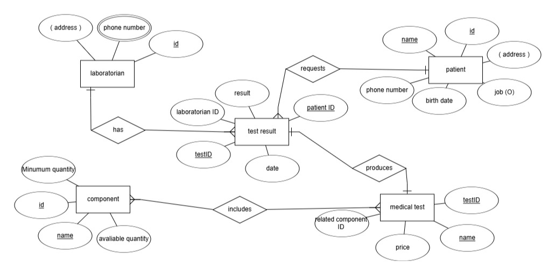
THE ERD
January 1, 2032

Slide 5

Examples of cardinality
•One patient can have many test results.
•One laboratorian can handle many test results.
•One medical test can be used in many test results.
•One component can be linked to many medical tests.

Slide 6
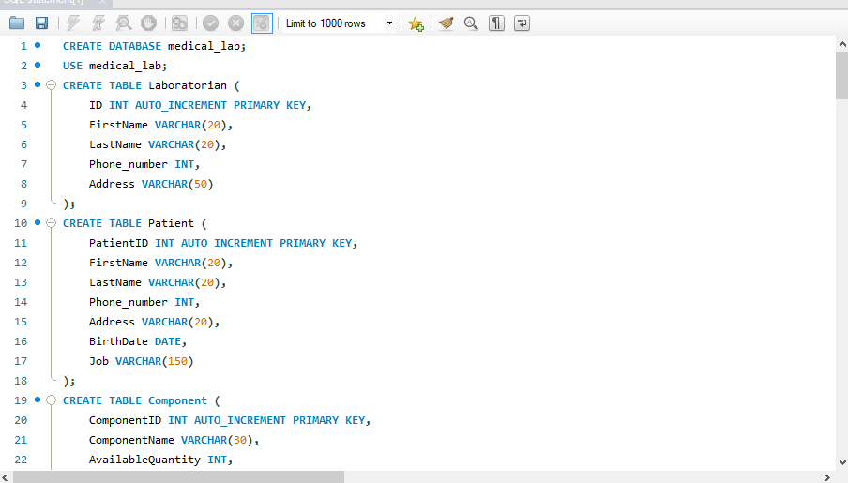

SQL SCHEMA

Slide 7
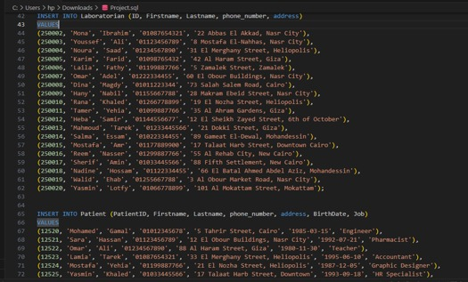
Inserting data into tables

Slide 8
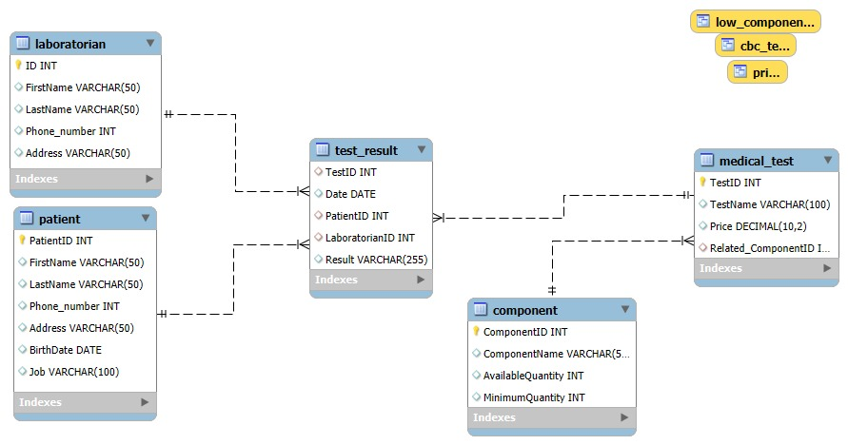
THE RELATIONAL

Slide 9
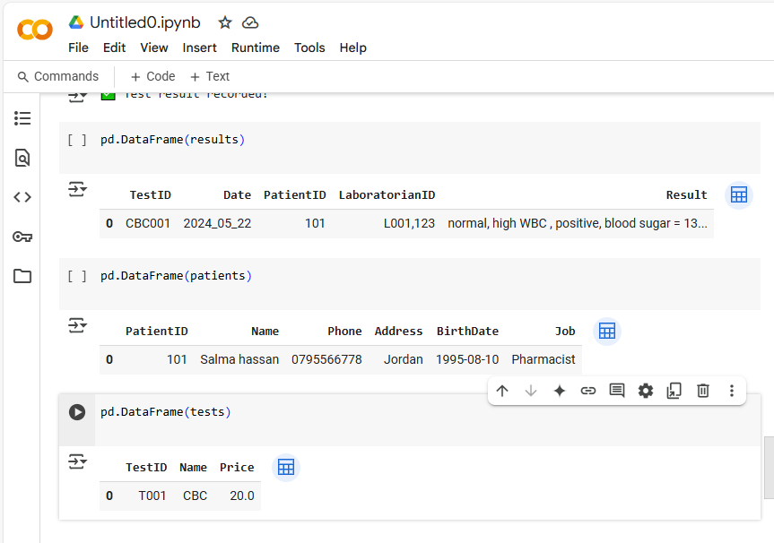
THE UI FOR DB
ADD OR VIEW DATA DYNAMICALLY

Slide 10

THANK YOU

